Slide 1


COVID-19 MONITOR Europe and central Asia
[Unless otherwise specified, data is as of March 12]
03/12/2021

Slide 2
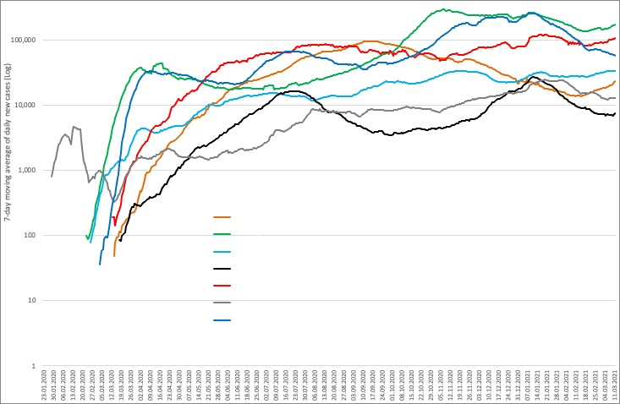
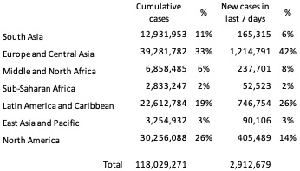
Daily new COVID-19 cases by World Bank regions (all countries)

Slide 3




Regional overview: COVID-19 cases, mortality, vaccination, and testing in client countries
CASES
DEATHS
VACCINATION
TESTS
Total:
24,169,864 cases
Last week:
+ 777,545 (3%)
Total:
509,009 deaths
Last week:
+ 15,090 (3%)
Total:
44,998,403 doses
Last week:
+ 6,720,856 (18%)
Total:
328,308,951 tests
Last week:
+ 10,310,375 (3%)
Last week: 5th - 12th March 2021

Slide 4
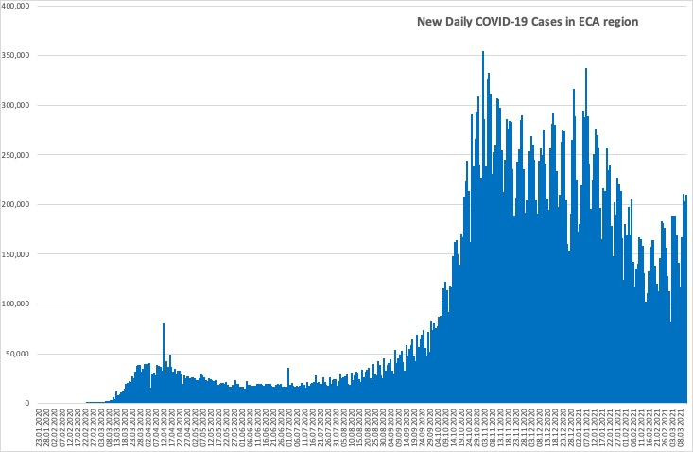
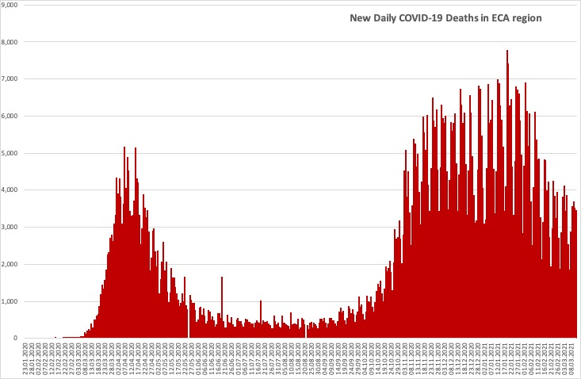
Daily new COVID-19 cases and deaths in ECA region (all countries)
Countries in the region have passed the second wave, seeing cases and deaths to be falling.

Slide 5
Country-level: cases, mortality and testing
Client countries | Cases per 100,000 | Deaths per 100,000 | Tests per 100,000 | Vaccines per 100,000 | Case Fatality Rate, % | Test Positivity Rate, %
Albania | 4,069 | 70.7 | 17,752 | 757 | 1.7 | 23.2
Armenia | 5,973 | 109.4 | 26,115 | NR | 1.8 | 23.0
Azerbaijan | 2,374 | 32.5 | 26,921 | 4,409 | 1.4 | 8.9
Belarus | 3,190 | 22.1 | 54,223 | 223 | 0.7 | 5.9
Bosnia and Herzegovina | 4,066 | 155.8 | 20,106 | NR | 3.8 | 20.2
Bulgaria | 3,968 | 161.1 | 26,433 | 4,843 | 4.1 | 15.1
Croatia | 6,107 | 138.1 | 34,952 | 6,488 | 2.3 | 17.6
Cyprus | 4,439 | 27.2 | 287,933 | 11,334 | 0.6 | 1.6
Czech Republic | 12,876 | 213.8 | 90,383 | 9,840 | 1.7 | 14.5
Estonia | 6,192 | 52.3 | 77,724 | 12,167 | 0.8 | 8.2
Finland | 1,179 | 14.2 | 64,875 | 11,755 | 1.2 | 1.9
Georgia | 7,357 | 97.4 | 80,243 | NR | 1.3 | 9.2
Greece | 2,024 | 65.1 | 54,609 | 11,694 | 3.2 | 3.8
Italy | 5,261 | 168.3 | 73,929 | 10,692 | 3.2 | 7.2
Kazakhstan | 1,457 | 17.1 | 43,122 | 119 | 1.2 | 2.8
Kosovo | 4,236 | 94.0 | NR | NR | 2.2 | NR
Kyrgyzstan | 1,359 | 23.2 | 12,337 | NR | 1.7 | 11.0
Latvia | 4,926 | 92.6 | 88,355 | 5,103 | 1.9 | 5.6
Lithuania | 7,507 | 123.9 | 81,389 | 12,885 | 1.7 | 9.3
North Macedonia | 5,348 | 157.9 | 27,258 | NR | 3.0 | 19.9
Moldova | 7,529 | 158.8 | 28,779 | 348 | 2.1 | 26.5
Montenegro | 13,277 | 179.5 | 49,498 | 542 | 1.4 | 27.2
Poland | 4,868 | 121.7 | 27,796 | 11,691 | 2.5 | 17.9
Portugal | 7,913 | 162.0 | 82,526 | 10,839 | 2.0 | 9.6
Romania | 4,380 | 110.0 | 34,831 | 10,658 | 2.5 | 12.7
Russia | 2,944 | 61.1 | 78,474 | 5,074 | 2.1 | 3.8
Serbia | 7,294 | 67.1 | 45,220 | 27,246 | 0.9 | 16.4
Slovakia | 6,121 | 153.0 | 40,292 | 10,949 | 2.5 | 15.4
Spain | 6,759 | 153.4 | 85,546 | 11,365 | 2.3 | 7.9
Tajikistan | 146 | 1.0 | NR | NR | 0.7 | NR
Turkey | 3,428 | 35.3 | 42,242 | 12,918 | 1.0 | 8.2
Ukraine | 3,554 | 70.3 | 17,508 | 114 | 2.0 | 19.9
Uzbekistan | 242 | 1.9 | 4,143 | NR | 0.8 | 5.8
Cases per 100,000 population range from 146 in Tajikistan to 13,277 in Montenegro.
Case fatality rates remain below 4.5% in all client countries.
There is significant variation in testing rates per 100,000 population from 4,143 in Uzbekistan to 287,933 in Cyprus.
The test positivity rate ranges from 1.6% in Cyprus to 27.2% in Montenegro.
The vaccination per 100,000 population ranges from 114 in Ukraine to 27,246 in Serbia.
* Data on vaccination number for
Belarus is the latest available, specifically as of February 18, 2021
Kazakhstan is the latest available, specifically as of February 24, 2021
Cyprus is the latest available, specifically as of March 7, 2021
Croatia is the latest available, specifically as of March 8, 2021
Albania is the latest available, specifically as of March 10, 2021
Estonia, Spain is the latest available, specifically as of March 11, 2021

Slide 6
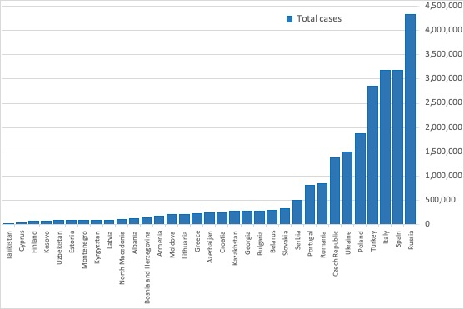
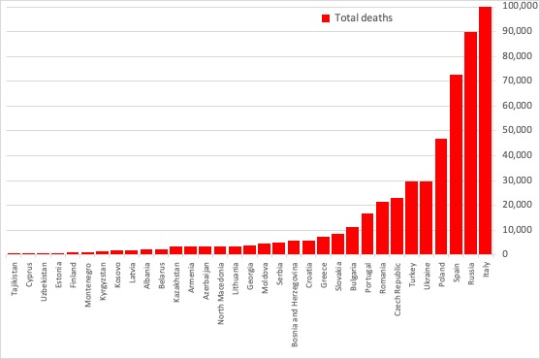
Total cases and deaths in client countries
Countries with the highest number of cases and deaths:
• Cases: Russia (4.321 M), Spain (3.183 M), Italy (3.175 M), Turkey (2.850 M), Poland (1.868 M).
• Deaths: Italy (101,564), Russia (89,701), Spain (72,258), Poland (46,724), Ukraine (29,434).
Countries with the lowest number of cases and deaths:
• Cases: Tajikistan (13,308), Cyprus (38,879), Finland (65,315), Kosovo (76,070), Uzbekistan (80,392).
• Deaths: Tajikistan (90), Cyprus (238), Uzbekistan (622), Estonia (695), Finland (786).

Slide 7
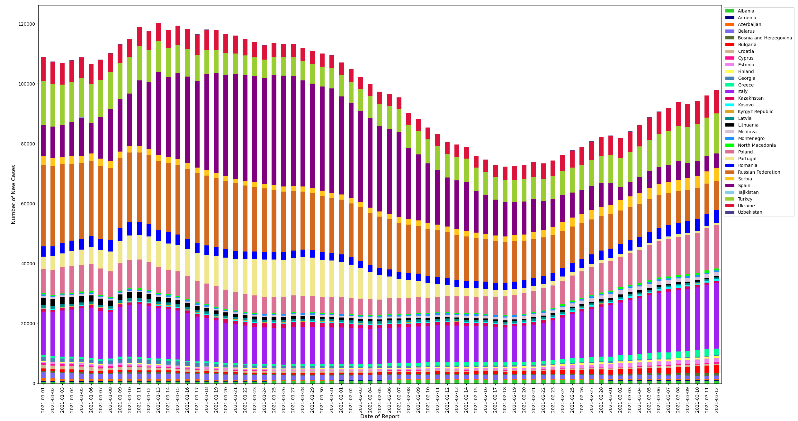
Rolling 7-day average of new cases
​This chart plots the 7-day average of new cases between January 1st and March 12th among client countries.
The contributions of Poland and Italy have been increasing relative to the other countries.
Note: Given the spike in case reporting on Monday, we re-distribute equally across Saturday, Sunday, and Monday in this case.

Slide 8
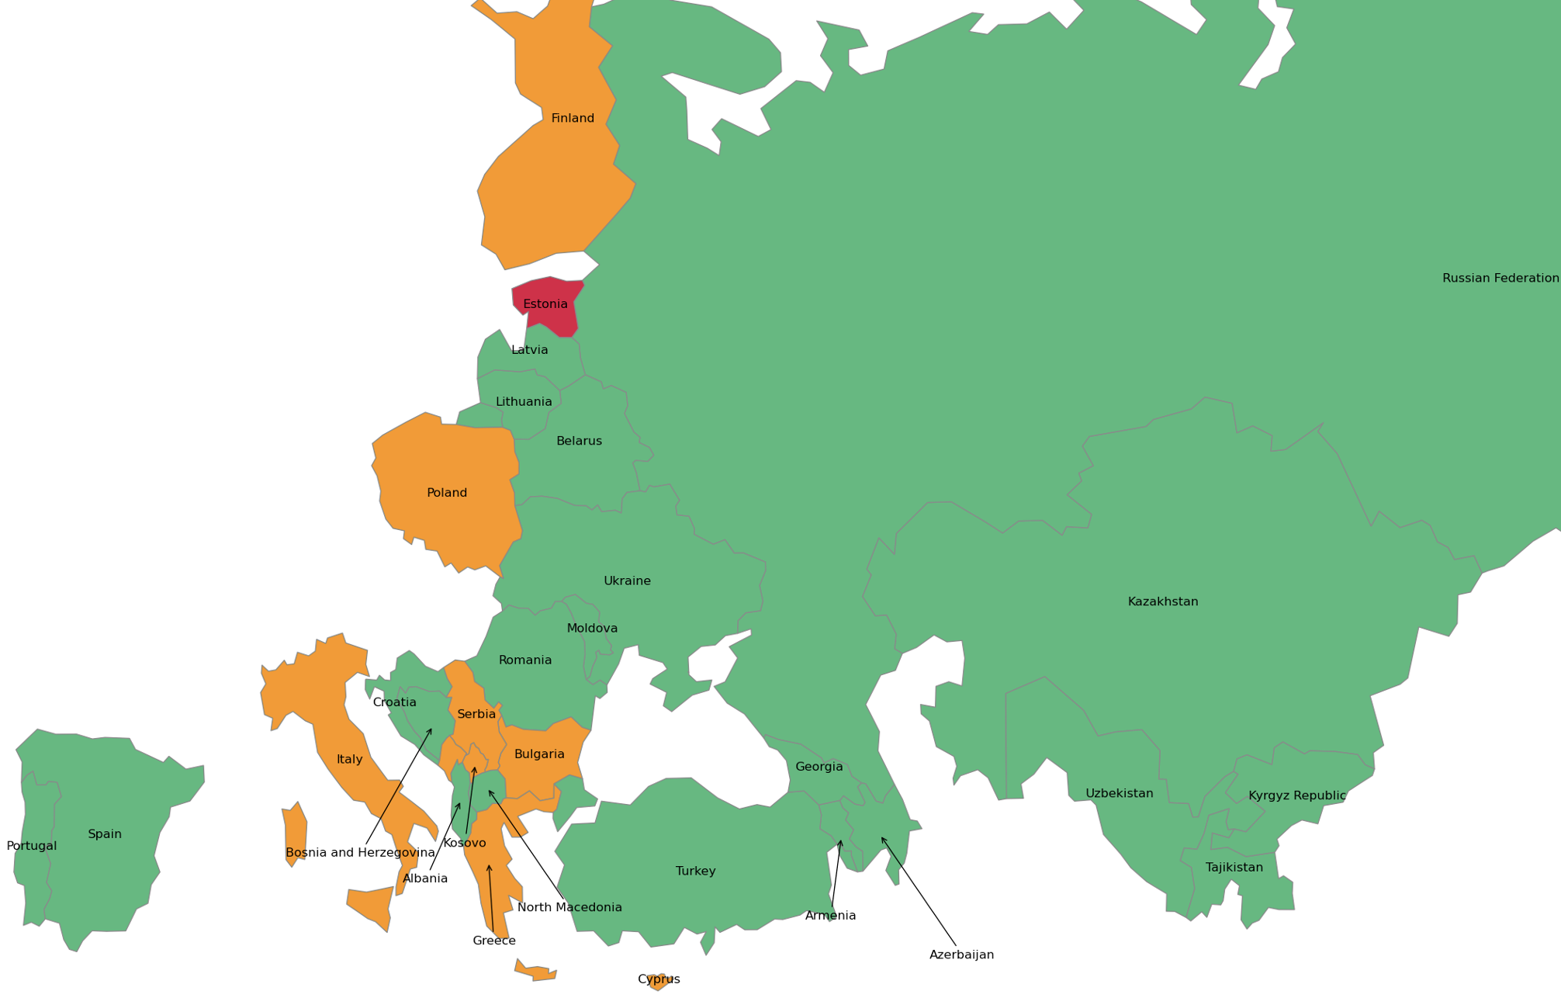
Most recent two-week span: percent increase in total cases
This map shows the % change in the total cases in the current week (March 6th to March 12th) compared to the preceding week (February 27th to March 5th).
Estonia (14%), Greece (8%) and Finland(7%) have recorded the highest percentage increases in total cases.
Estonia has recorded percentage increase above 10% for three consecutive weeks.
Color | Percent Increase | Countries
 | 0% - 5% | Kazakhstan, Uzbekistan, Russian Federation, Tajikistan, Kyrgyz Republic, Armenia, Belarus, Ukraine, Moldova, Romania, Lithuania, Latvia, Turkey, Albania, Croatia, Portugal, Spain, Azerbaijan, Georgia, Bosnia and Herzegovina, North Macedonia.
 | 5% - 10% | Poland, Bulgaria, Greece, Italy, Finland, Cyprus, Serbia, Montenegro, Kosovo.
 | > = 10% | Estonia.
Note: Boundaries were cleared by the World Bank Map Design Cartography and Map Clearance Teams.

Slide 9
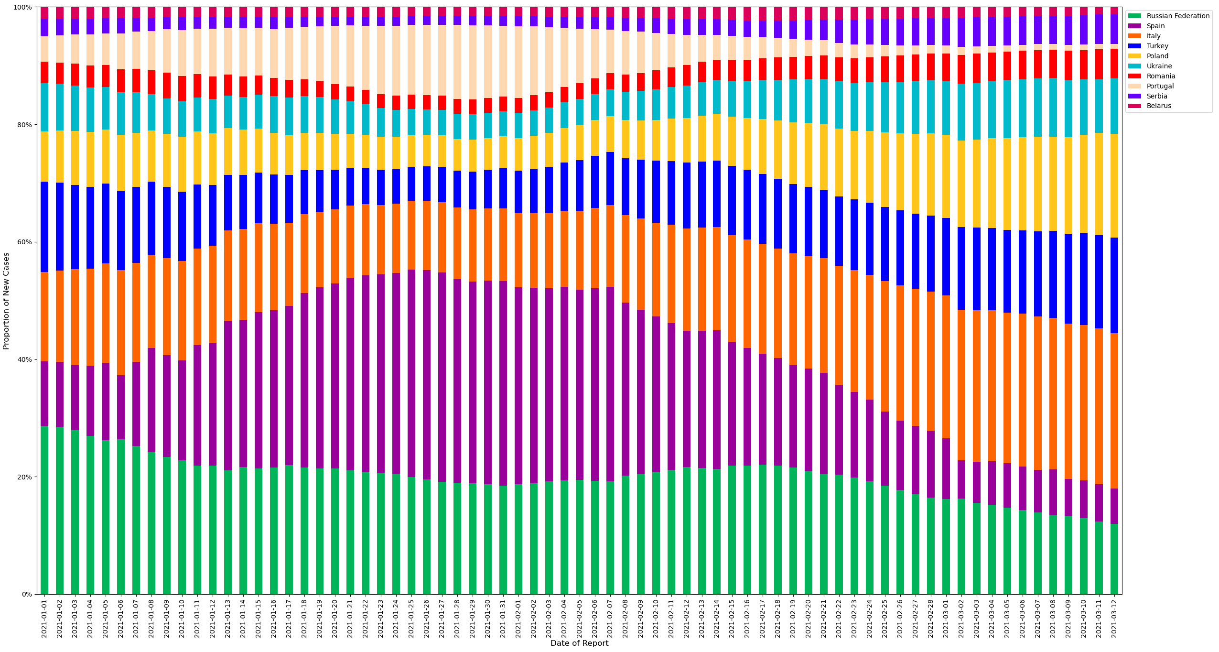
Relative contributions of the 10 client countries with highest case incidence
​This chart plots the proportion of new cases of the total cases in the region between January 1st and March 5th among countries with the highest levels of case incidence.
The 7-day rolling average is computed to adjust for variation in reporting.
The percentage contribution of cases in Ukraine, Poland and Italy is increasing.

Slide 10
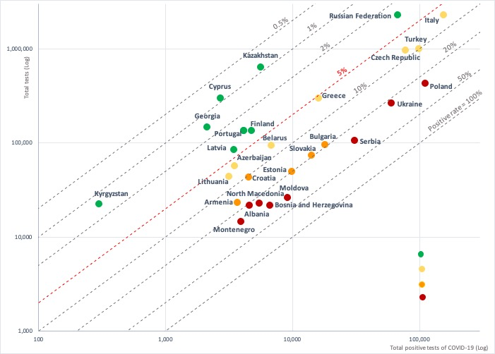

Test positivity rate: total positive COVID-19 tests versus total tests conducted
A test positivity rate of less than 5% is one criterion for informing adjusting of public health and social measures by WHO.
The following countries have testing rates above 5% indicating the need to increase testing and strengthen measures to slow transmission:
Albania, Bosnia and Herzegovina, North Macedonia, Moldova, Montenegro, Poland, Serbia, and Ukraine have positive rates of above 20%;
Armenia,Bulgaria, Croatia, Estonia, and Slovakia have positive rates of 10-20%;
Azerbaijan, Belarus, Czech Republic, Greece, Italy, Lithuania, and Turkey have positive test rates of 5-10%.

Slide 11
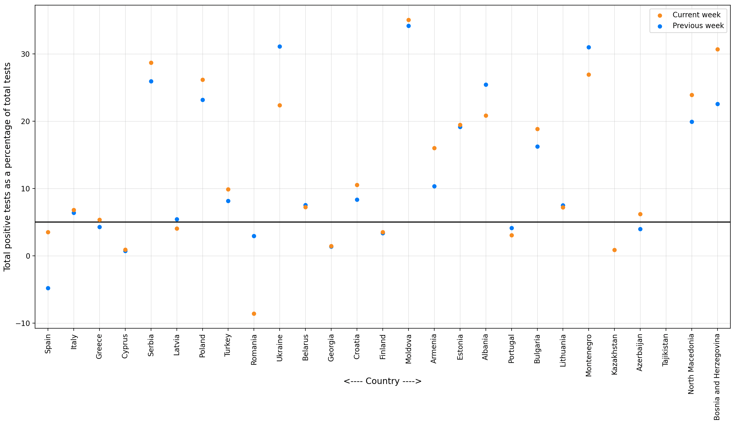
Most recent two-week span: change in test positivity rate
This graph plots the test positivity rate the current week (March 6th to March 12th) compared to the preceding week (February 27th to March 5th).
Over the past week, the test positivity rates in Greece increased from below 5% to above 5%.
Albania, Moldova and Serbia have recorded rates above 25% for two consecutive weeks.

Slide 12
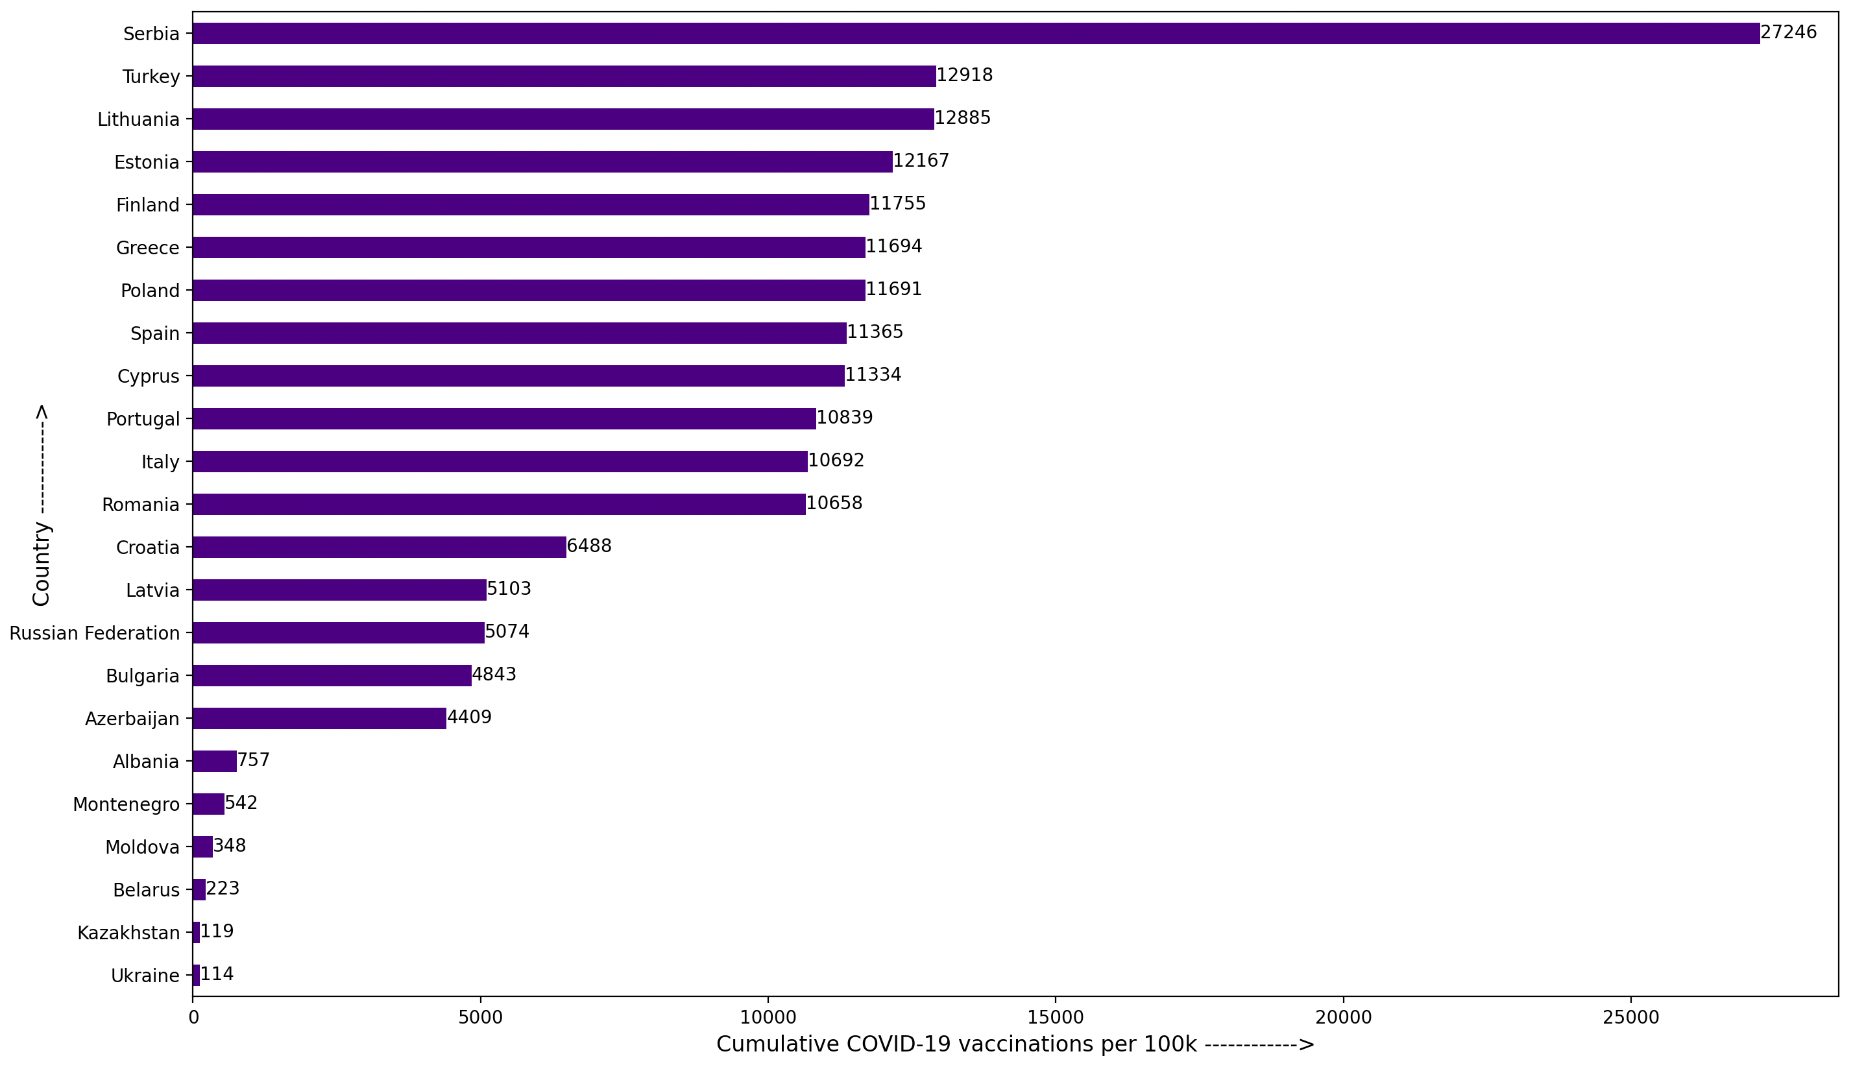
Total COVID-19 vaccines administered per 100,000 population
This chart plots the total vaccines administered per 100,000 population up until March 12th among client countries.
Serbia (27,246), Turkey (12,918) and Lithuania (12,885) have administered the highest number of vaccines per 100,000 population.
Armenia, Bosnia and Herzegovina, Georgia, Kosovo, Kyrgyz Republic, Montenegro, Tajikistan and Uzbekistan have no vaccination data available.

Slide 13
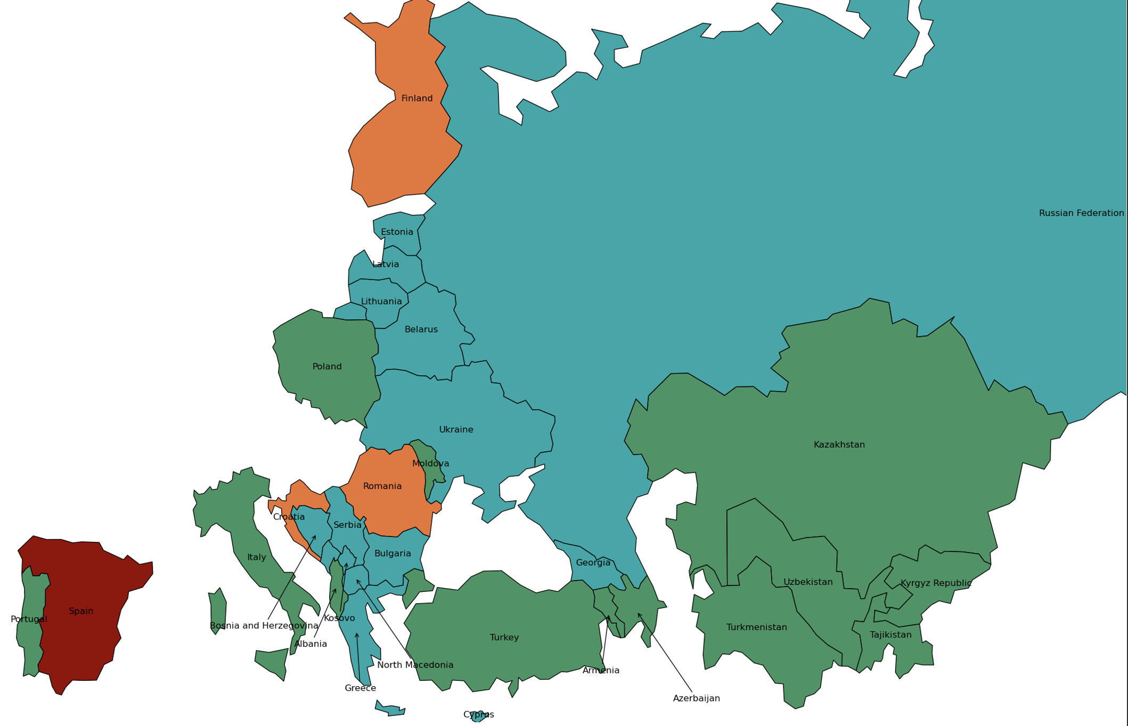
Spread of Coronavirus variants of concern amongst client countries
This map shows the number of Coronavirus variants of concern (B1.1.7, B.1.351, P.1) present in the client countries up until March 5th.
Variants of concern appear to be more infectious than other circulating Coronaviruses.
Coronaviruses from the B.1.1.7 lineage are thought to be roughly 50 percent more infectious as its transmissibility is greater 40% with increase in virulence/mortality.
Variant B.1.351 has a transmissibility greater than 50%, with a potential for immune escape.
P.1, first found in Japan is a close relative of the B.1.351 lineage, and is also potentially associated with reinfections.
Spain (B1.1.7, B.1.351, P.1) has reported the three Coronavirus variants of concern.
Color | Total Variants | Countries
 | 0 | Kazakhstan, Uzbekistan, Tajikistan, Kyrgyz Republic, Turkmenistan, Armenia, Poland, Moldova, Turkey, Albania, Portugal, Italy, Azerbaijan.
 | 1 | Russian Federation, Belarus, Ukraine, Lithuania, Latvia, Estonia, Bulgaria, Greece, Georgia, Cyprus, Bosnia and Herzegovina, North Macedonia, Serbia, Montenegro, Kosovo.
 | 2 | Romania, Croatia, Finland.
 | 3 | Spain.
Note: Boundaries were cleared by the World Bank Map Design Cartography and Map Clearance Teams.

Slide 14
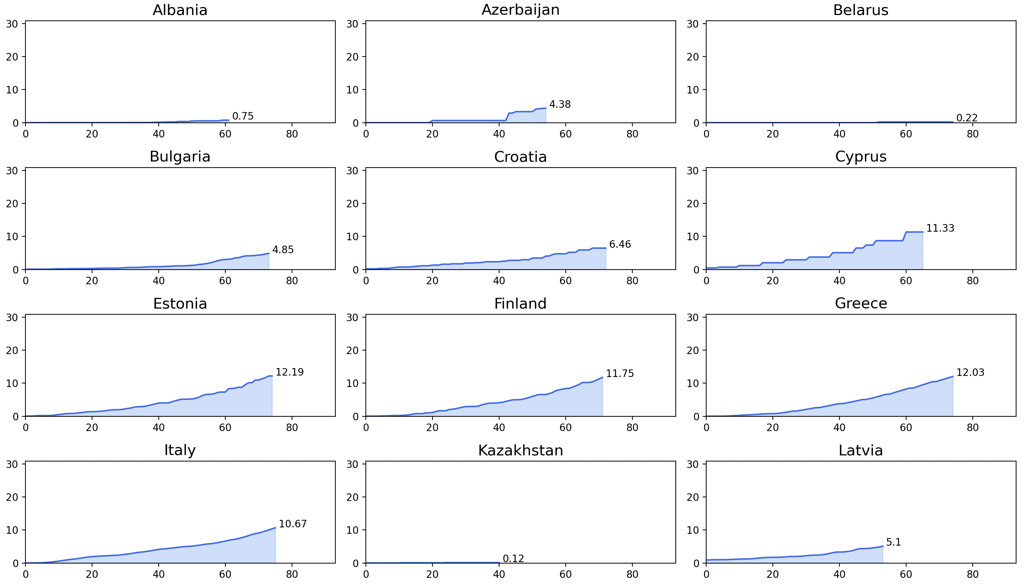
Total vaccine doses administered per 100 people in client countries
This chart plots the total vaccine doses administered per 100 people up until March 12th among client countries.
Rate of vaccinations is highest in Serbia followed by Turkey and it is lowest in Kazakhstan.

Slide 15
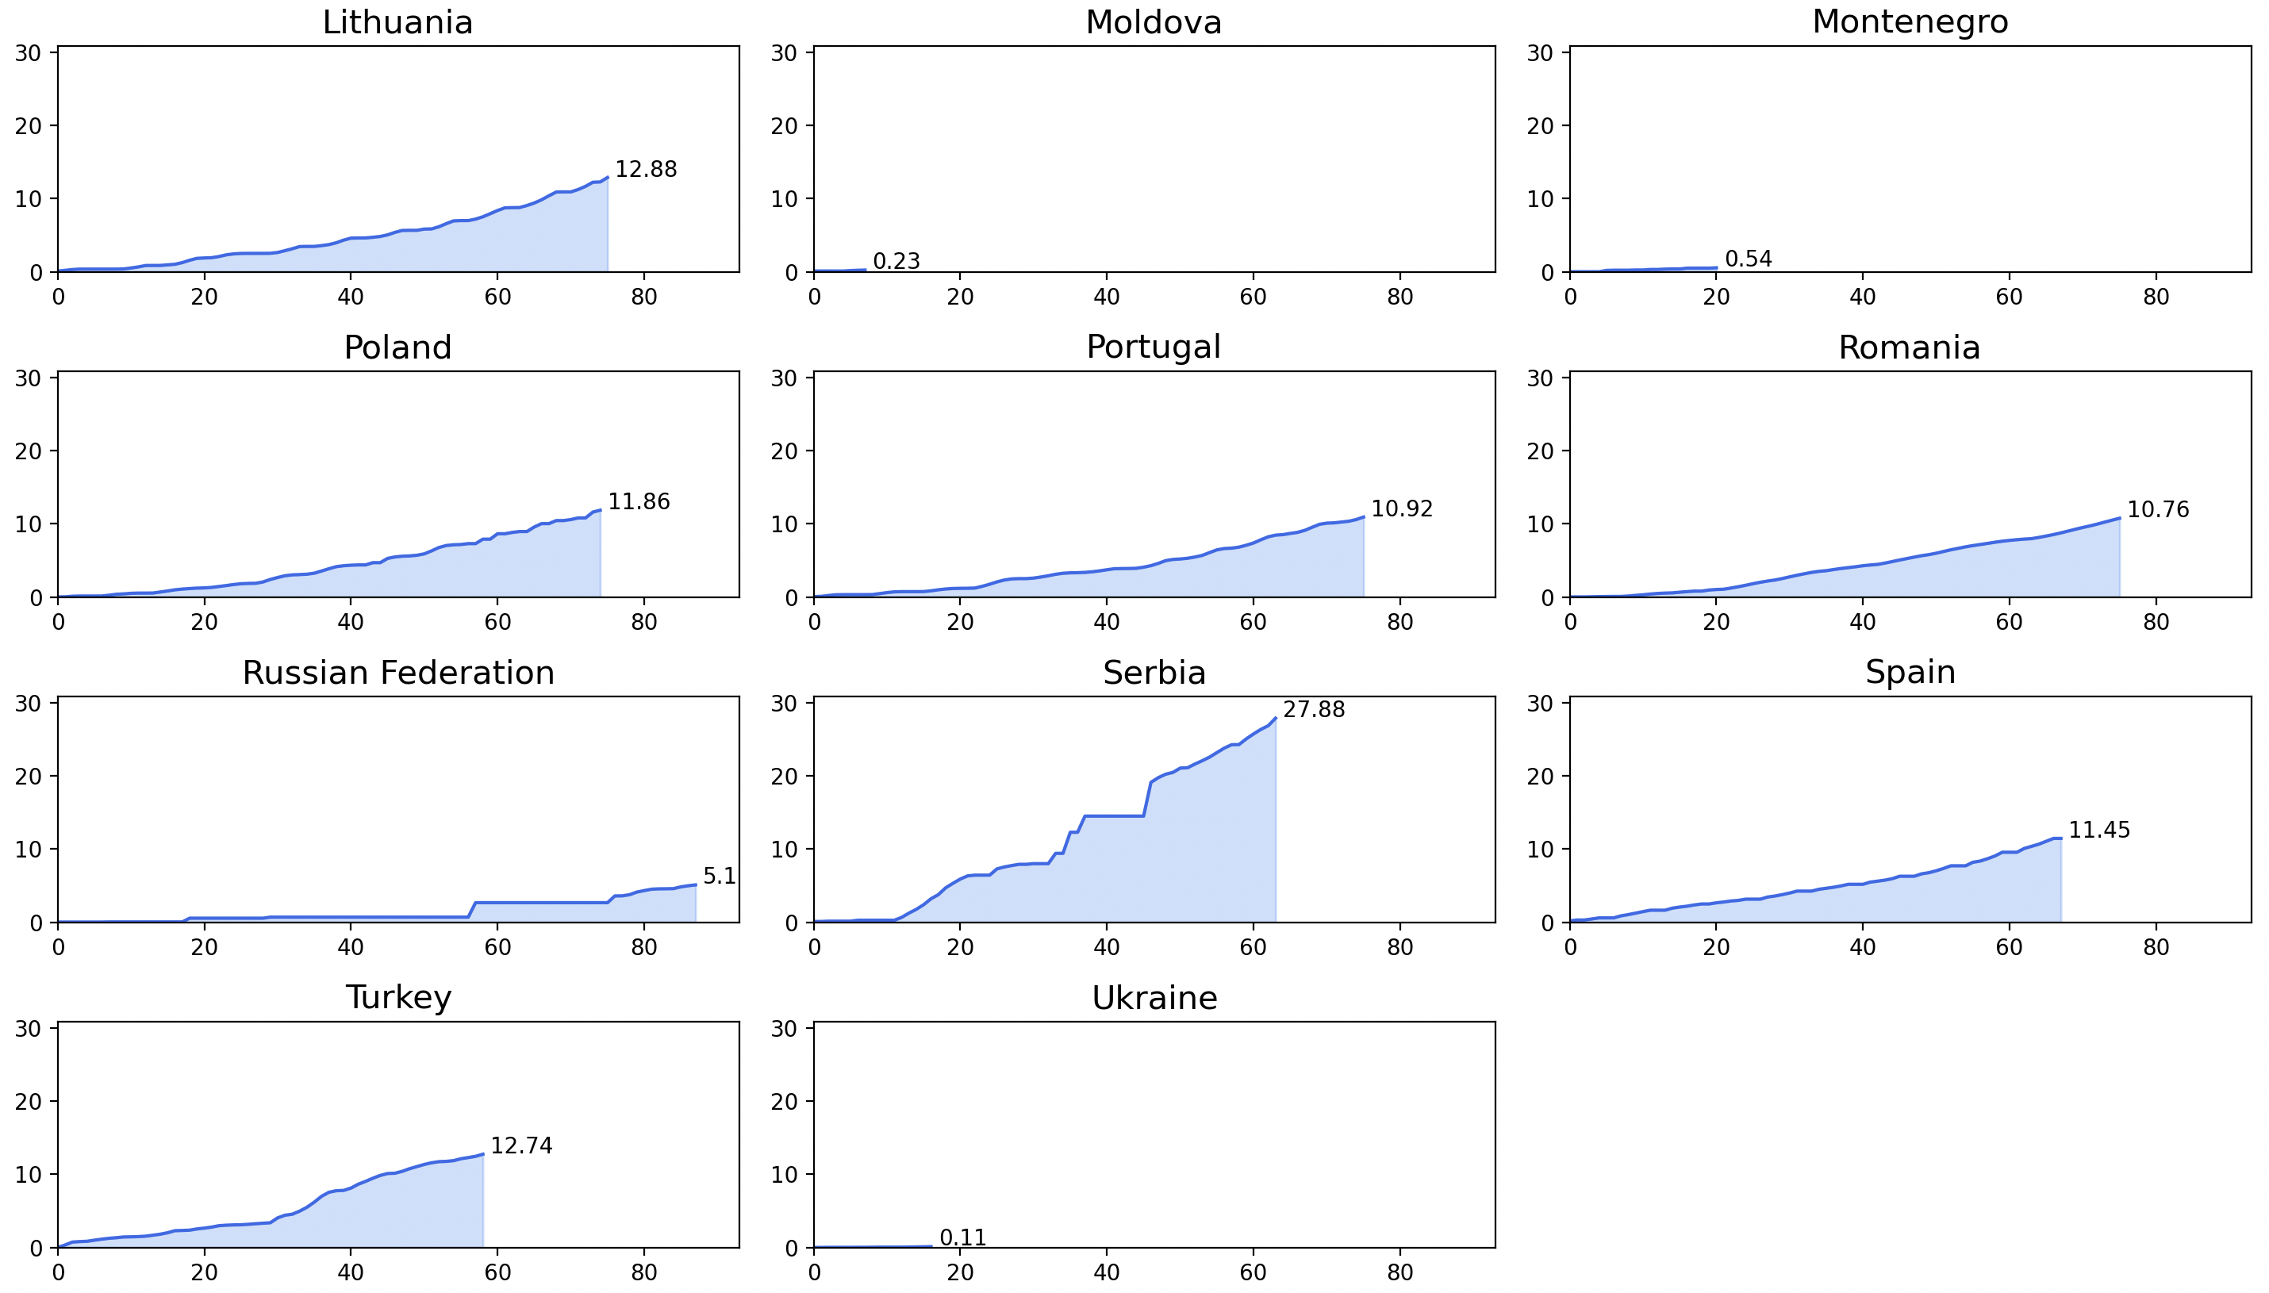
Total vaccine doses administered per 100 people in client countries
This chart plots the total vaccine doses administered per 100 people up until March 12th among client countries.
Rate of vaccinations is highest in Serbia followed by Turkey and it is lowest in Kazakhstan.

Slide 16
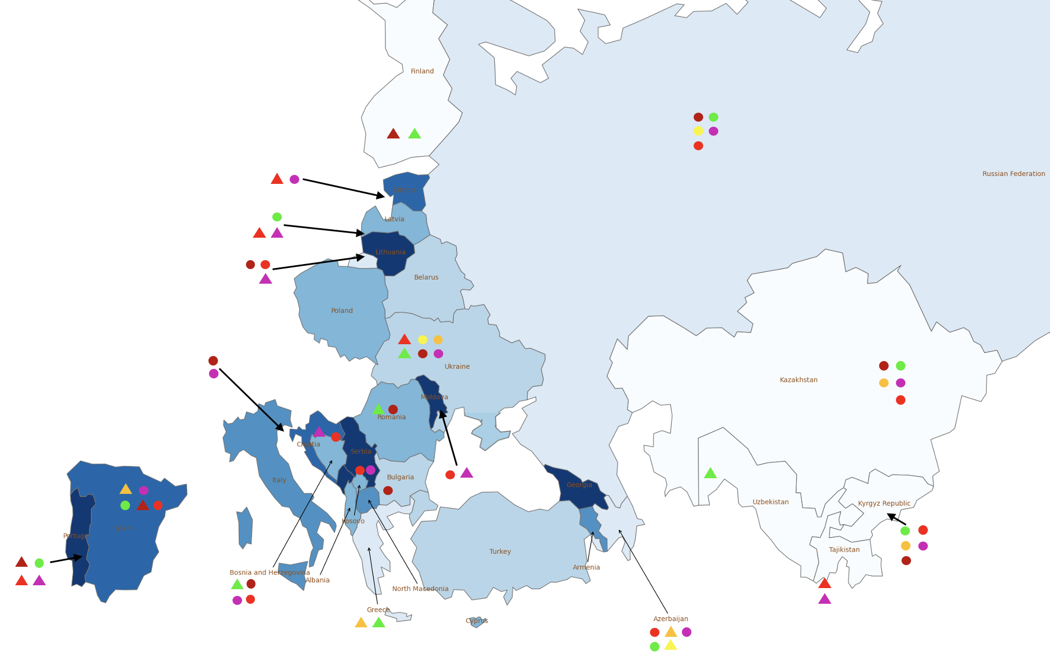
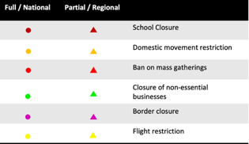
Public health and social measures implemented in the region
Color | Total cases /100,000 | Countries
 | 0 - 1500 | Kazakhstan, Uzbekistan, Tajikistan, Kyrgyz Republic, Finland.
 | 1500 - 3000 | Russian Federation, Greece, Azerbaijan.
 | 3000 - 4000 | Belarus, Ukraine, Bulgaria, Turkey.
 | 4000 - 5000 | Poland, Romania, Latvia, Albania, Cyprus, Bosnia and Herzegovina, Kosovo.
 | 5000 - 6000 | Armenia, Italy, North Macedonia.
 | 6000 - 7000 | Estonia, Croatia, Spain.
 | 7000+ | Moldova, Lithuania, Portugal, Georgia, Serbia, Montenegro.
Croatia is working on bilateral agreements (Covid passports) to facilitate the crossing of its borders for those vaccinated against the novel coronavirus without the need to present a negative PCR test, in order to facilitate easier traffic during the tourist season.
In the last seven days 1,111 people per million inhabitants have received a positive coronavirus test result in Estonia, which is the highest figure in the world.
The Chinese government will provide Kyrgyzstan with free COVID-19 vaccines, Chinese Ambassador Du Dewen said during a meeting with Kyrgyz Foreign Minister Ruslan Kazakbaev.
Ukraine has agreed on the supply of 500,000 doses of Indian-made COVISHIELD vaccine against COVID-19.
Note: Boundaries were cleared by the World Bank Map Design Cartography and Map Clearance Teams.

Slide 17
Countries and data sources
Albania | Georgia | Poland
Armenia | Greece | Portugal
Azerbaijan | Italy | Romania
Belarus | Kazakhstan | Russian Federation
Bulgaria | Kosovo | Serbia
Bosnia and Herzegovina | Kyrgyz Republic | Slovak Republic
Croatia | Latvia | Spain
Cyprus | Lithuania | Tajikistan
Czech Republic | Moldova | Turkey
Estonia | Montenegro | Turkmenistan (no cases)
Finland | North Macedonia | Ukraine
 |  | Uzbekistan
The monitor focuses on client countries in Europe and Central Asia with any lending or non-lending operations, and with available data, as in the Table.
Data:
Cases and deaths: https://ourworldindata.org/coronavirus
Testing: https://www.worldometers.info/coronavirus/
Policy responses: https://ourworldindata.org/policy-responses-covid
Population: provided by task teams or imputed from “our world in data”.
Variants:
https://cov-lineages.org/global_report.html
https://www.nytimes.com/interactive/2021/health/coronavirus-variant-tracker.html

